Slide 1
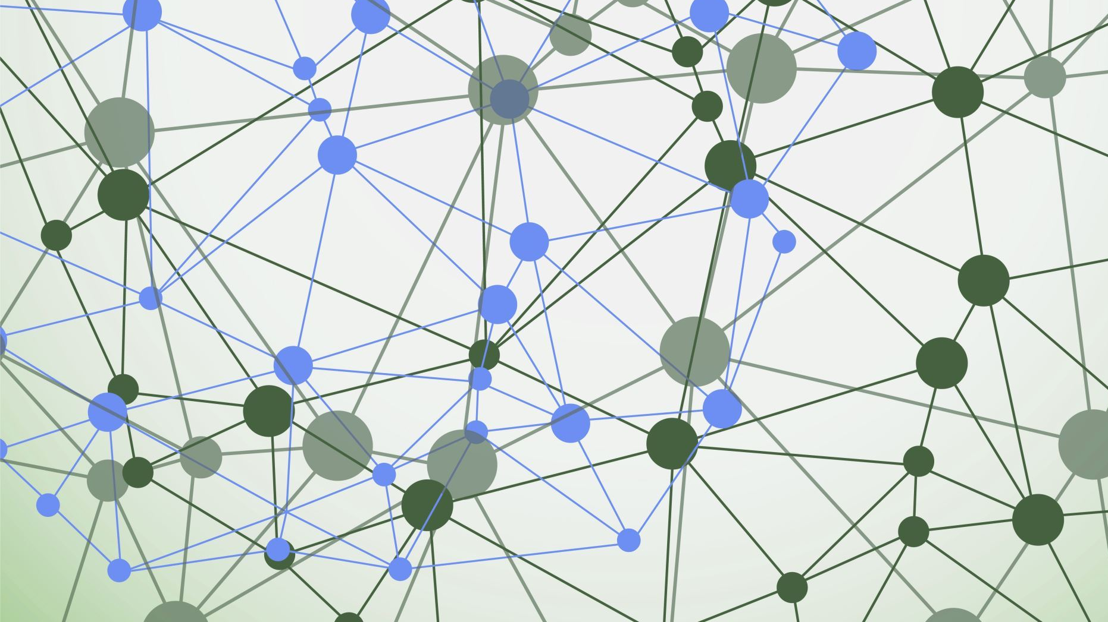
EvENGage
MES Event and Form Management Platform

Slide 2
PRESENTATION ROADMAP
1
2
3
4
Part 1
Part 2
Part 3
Part 4
Motivation
Demo
Technical Highlights
Iteration, Validation & Beyond
Project Background and Problem Setting
Goals
Product Demonstration
Expansiveness
Modularity
Platform Perks
UI testing & improvement
Acceptance Testing
Recap
Next Steps
Notes:
To give you an idea of what you can look forward to today, we'll start off by providing our project background: the current issues our client, the MES, is facing and framing our product goals to create something which will provide real value to the MES
Then we'll give you a comprehensive demonstration of our platform and all its amazing features and how they address the MES's pain points
We'll then go over some technical design features which showcase what makes our platform ideal and unique
And finally, we will go over how our product has been improved through iteration and validation methods and how our product progresses from here

Slide 3
Motivation
The McMaster Engineering Society hosts large-scale events year-round, including Fireball Formal, Pub Nights, and the CALE Conference
They also conduct and collect data for surveys, including the CFES National Survey
A Google form with 71 pages
Registrations, attendance, and payments are tracked manually through spreadsheets
Form responses are collected through Google Forms without analytics or true ownership of the data
Forms lengths are also daunting and their contents repetitive, discouraging completion
Overall, the system is a nightmare, and needs centralization and automation
Notes:
So the MES hosts a ton of events throughout the year — Fireball Formal, Pub Nights, CALE Conference. But behind the scenes, it's a mess. Registrations and payments are being tracked manually in Excel. Surveys are thrown together in Google Forms with no real storage or analytics behind them. And every single event, organizers are rebuilding everything from scratch because nothing carries over. There's no single system — it's just a bunch of disconnected tools that don't talk to each other. That's the core problem we're solving.

Slide 4
Goals
Develop a custom Modular Form Builder
Create a streamlined Event Creation and Registration process
Provide detailed and intuitive data analytics and visualization
Provide a centralized location for attendee and admin information management

Slide 5
Demo

Slide 6
The Tech Stack
Web App:
Vite
NodeJS
Drizzle ORM
PostgreSQL
Mobile App:
React-Native
Tanstack Router
Expo

Slide 7
Tech Stack Advantages
Fast Development and Debugging
Easy to Deploy
Easy Expandability and Modularity through Packages
Universal Compatibility on various platforms

Slide 8
Easy Expandability
Component-Based development
Separate form and event processes
API-Based Architecture

Slide 9
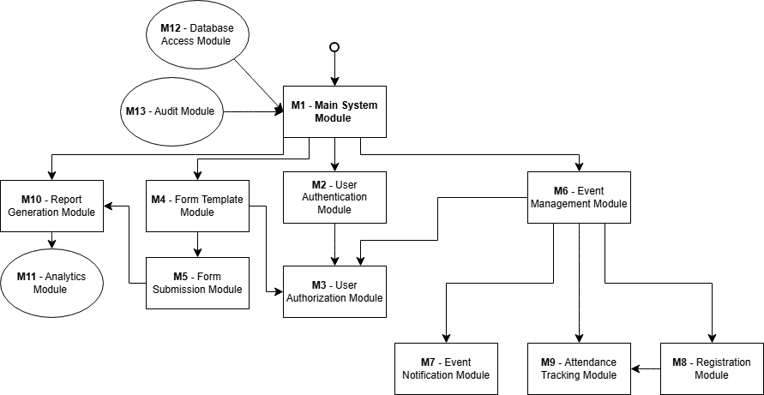
Design Modularity

Slide 10
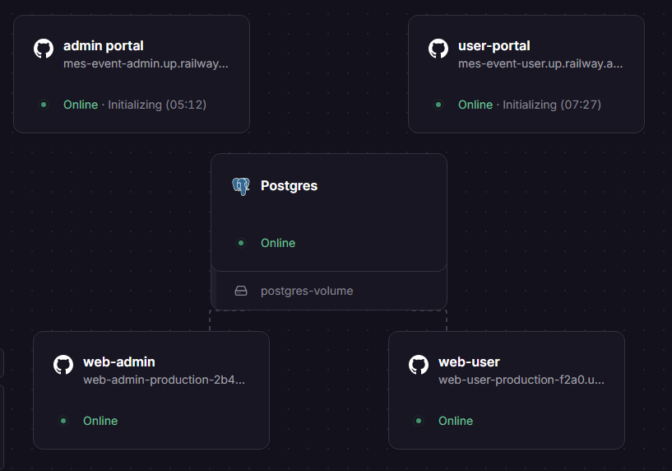
Separate Admin and User Portals
Role-based UX: Each portal and web-app has separate focuses and experiences based on the requirements.
Security isolation: Admin portal with strict authentication separate from public user registration.
Simpler deployment & maintenance: Different feature releases possible on each app

Slide 11
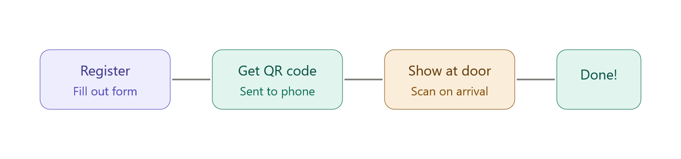
QR Code Ticketing
No hardware needed: Works with any smartphone/tablet and doesn’t require any external hardware
Fraud prevention: Server-side validation marks tickets as used after first scan to prevent duplicates and screenshot spoofing
Speed & scalability: Full entry in 2-3 seconds vs. 30+ seconds for photo ID matching; can handle 1000+ attendees simultaneously
Seamless Registration Process:

Slide 12
Usability Testing
High emphasis for us to ensure product was usable and matched requirements
Usability testing with both admin and student users
Changes range from purely aesthetic, QOL changes to changing base functionality for better workflows.

Slide 13
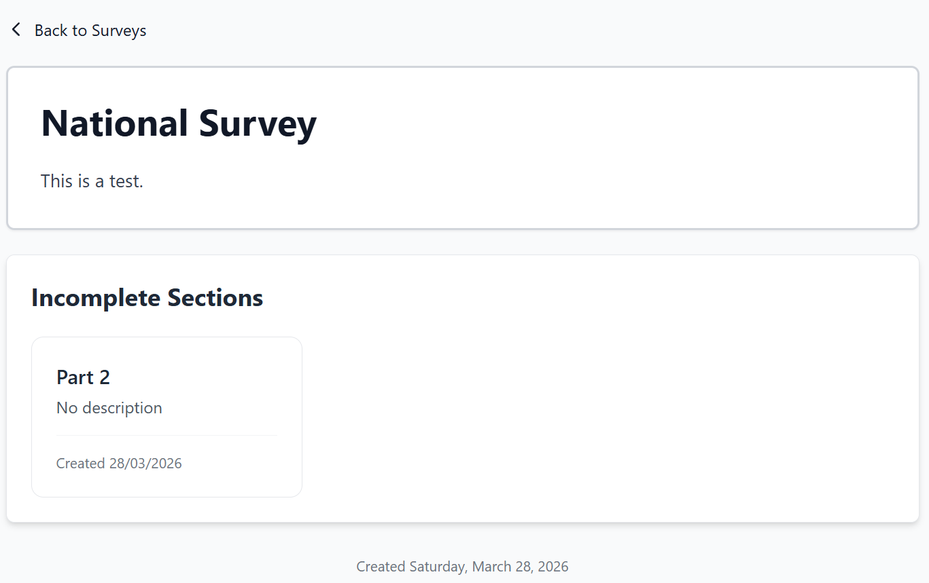
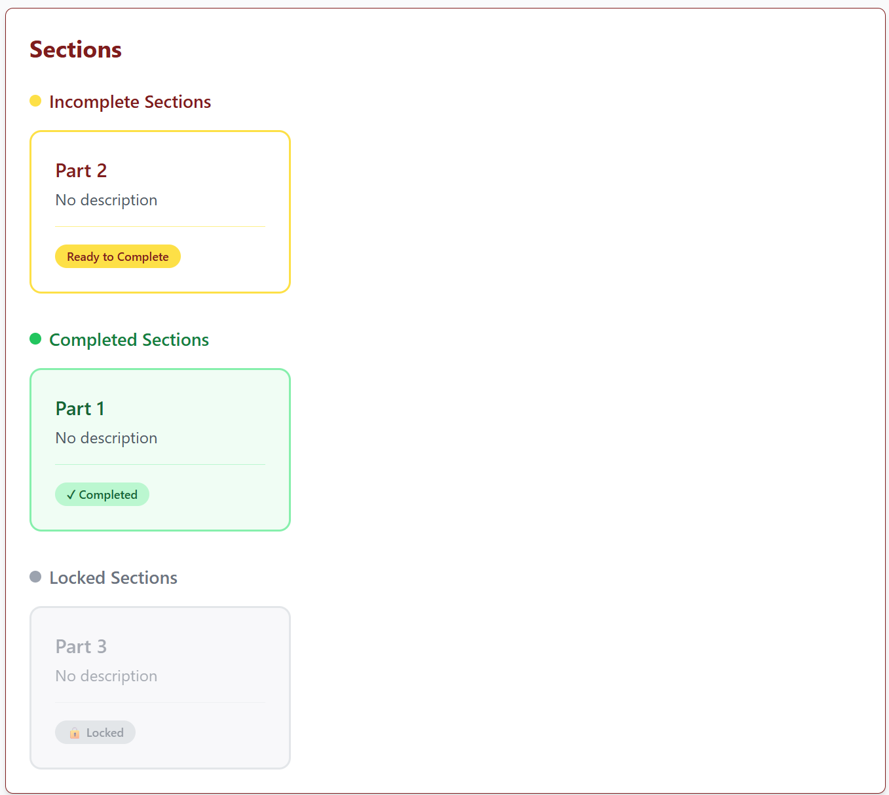
Example #1:
Old Design
New Design

Slide 14
Example #2:
Old Design
New Design

Slide 15
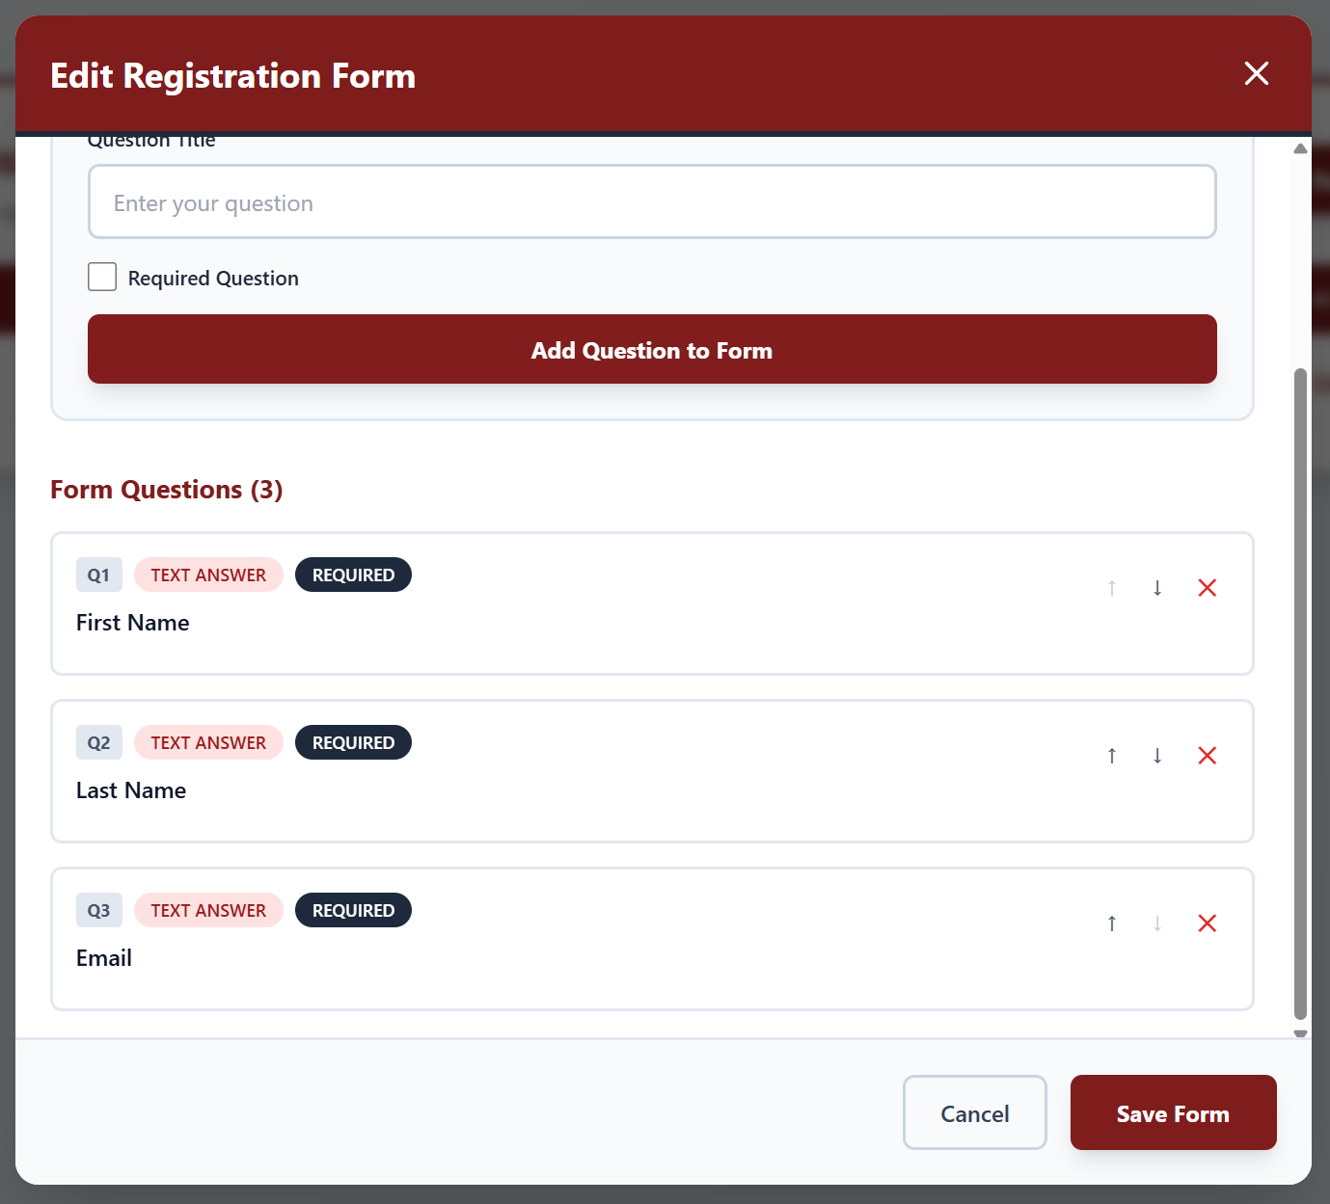
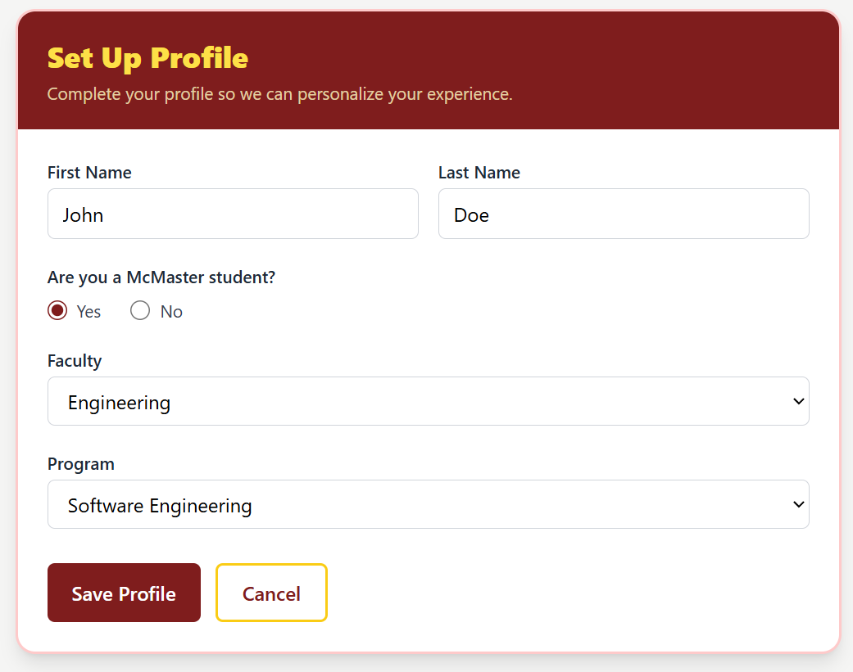
Example #3:
Old Design
New Design

Slide 16
Acceptance Testing
Focused on dynamic testing with all the use cases, rather than per feature
Ensured all the requirements we set out were met and verified
Performed acceptance testing with our supervisor to ensure his initial requirements and intentions were reached

Slide 17
Advantages of our Platform
All aspects of event and survey management are centralized into one platform
Higher level of control for admins, with much more efficient workflows
Easier registration and check-in for users
Modular surveys to make larger forms easier to digest

Slide 18
Next Steps
Polishing
Making product deployment-ready
Stronger McMaster email and environment integration
Payment system configuration
Deployment environment configuration
Extension
White-label/SAAS product
Allow other McMaster societies or other organizations to manage their events
AI-powered insights & analytics

Slide 19
Questions?

